Slide 1

Idea on Classes , Objects ,Writing My first Java Program ,OOPS Concepts
Saurabh Kandhway

Slide 2


Slide 3
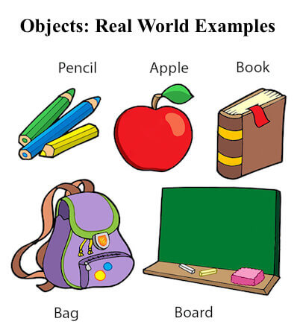
Objects and Classes in Java
An object in Java is the physical as well as a logical entity, whereas, a class in Java is a logical entity only.
An entity that has state and behavior is known as an object e.g., chair, bike, marker, pen, table, car, etc. It can be physical or logical (tangible and intangible). The example of an intangible object is the banking system.

Slide 4
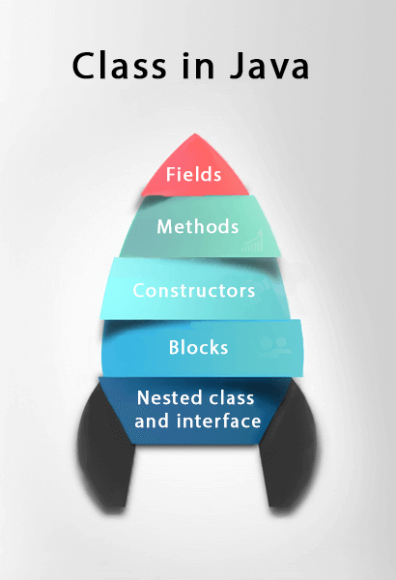
What is Class in Java
A class is a group of objects which have common properties. It is a template or blueprint from which objects are created. It is a logical entity. It can't be physical.
A class in Java can contain:
Fields
Methods
Constructors
Blocks
Nested class and interface

Slide 5
My First Java Program
class A
{
public static void main(String args[])
{
System.out.println("Hello World");
}
}

Slide 6
Steps to Write First Java Program
Declare a class with name A.
1
Declare the main method public static void main(String args[]){
2
Now Type the System.out.println(“Hello World”); which will print Hello World in Java
3

Slide 7
Detailed Discussion on Java Program
1. Public
It is an Access modifier, which specifies from where and who can access the method. Making the main() method public makes it globally available. It is made public so that JVM can invoke it from outside the class as it is not present in the current class.
2. Static
It is a keyword that is when associated with a method, making it a class-related method. The main() method is static so that JVM can invoke it without instantiating the class. This also saves the unnecessary wastage of memory which would have been used by the object declared only for calling the main() method by the JVM.

Slide 8
Continued..
3. Void
It is a keyword and is used to specify that a method doesn’t return anything. As the main() method doesn’t return anything, its return type is void. As soon as the main() method terminates, the java program terminates too. Hence, it doesn’t make any sense to return from the main() method as JVM can’t do anything with the return value of it.
4. main
It is the name of the Java main method. It is the identifier that the JVM looks for as the starting point of the java program. It’s not a keyword.

Slide 9
Continued..
5. String[] args
It stores Java command-line arguments and is an array of type java.lang.String class. Here, the name of the String array is args but it is not fixed and the user can use any name in place of it.

Slide 10
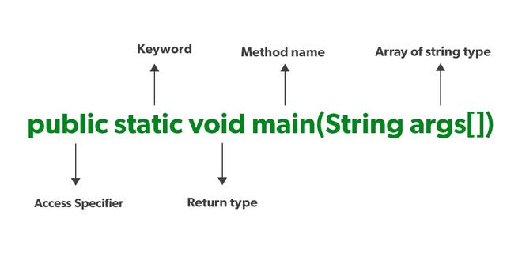
Who Am I in Public static void main

Slide 11
Important Points
In the case of Java, it is the magic of Bytecode that makes it platform independent.
This adds to an important feature in the JAVA language termed as portability. Every system has its own JVM which gets installed automatically when the jdk software is installed. For every operating system separate JVM is available which is capable to read the .class file or byte code.
An important point to be noted is that while JAVA is platform-independent language, the JVM is platform-dependent. Different JVM is designed for different OS and byte code is able to run on different OS.

Slide 12
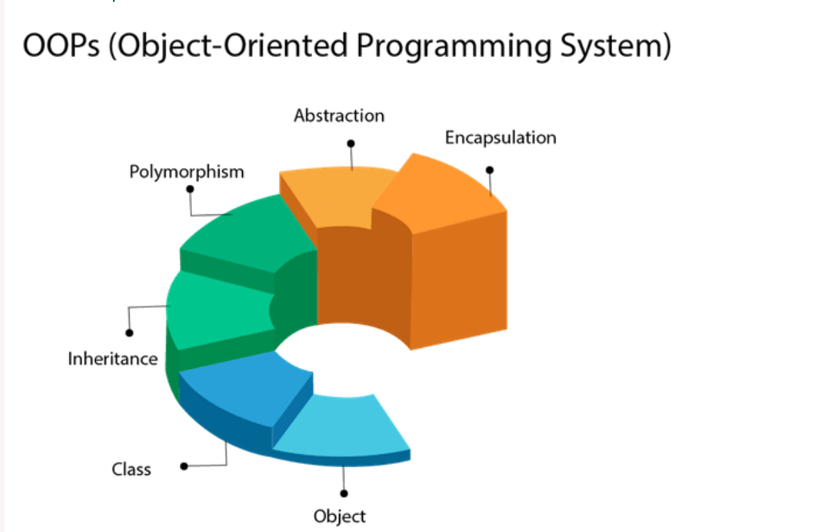
OOPS Concept in java
Object-Oriented Programming is a methodology or paradigm to design a program using classes and objects.
There are major 4 OOPs Concept in Java

Slide 13
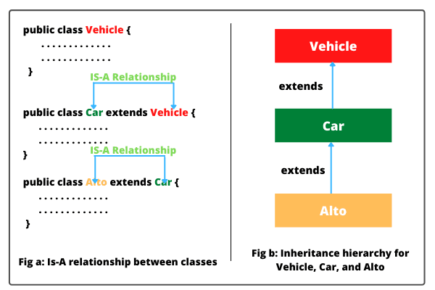
Inheritance in java
Inheritance in Java is a mechanism in which one object acquires all the properties and behaviors of a parent object. It is an important part of OOPs (Object Oriented programming system).

Slide 14
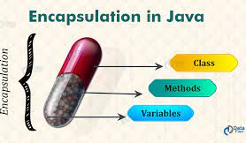
Encapsulation
Encapsulation in Java is a process of wrapping code and data together into a single unit, for example, a capsule which is mixed of several medicines.
We can create a fully encapsulated class in Java by making all the data members of the class private. Now we can use setter and getter methods to set and get the data in it.

Slide 15
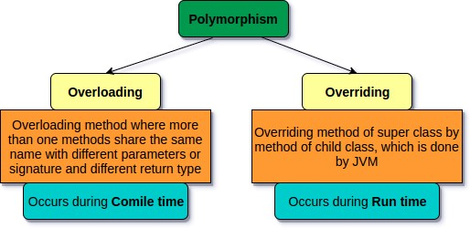
Polymorphism
Polymorphism in Java is a concept by which we can perform a single action in different ways. Polymorphism is derived from 2 Greek words: poly and morphs. The word "poly" means many and "morphs" means forms. So polymorphism means many forms.

Slide 16
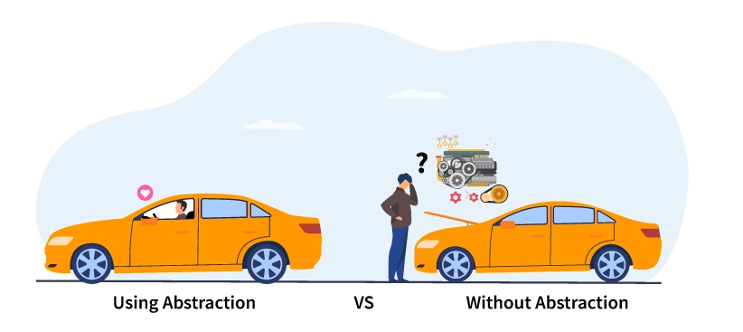
Abstraction in java
Data Abstraction is the property by virtue of which only the essential details are displayed to the user. The trivial or the non-essential units are not displayed to the user. Ex: A car is viewed as a car rather than its individual components.

